Slide 1
SettINg Up a CAB
Recruiting Site CAB Members—Where to Recruit
Most PHACS site staff and CAB members recruit directly at the site:
Using flyers/posters
During study visits
From other CABs/community organizations at the study site.
Recruitment may occur at:
Schools;
Places of worship; and
Public health events.
Notes:
Recruiting Site CAB Members—Where to Recruit
Current CAB members, Study Coordinators, and CAB Liaisons may recruit new site CAB members at any location or event where they might find eligible site CAB members. Most PHACS site staff and CAB members recruit directly at the study site. This may include hanging posters and flyers in the clinic.
Some study nurses or social workers recruit parents/caregivers during study visits. Others recruit CAB members from other CABs/community organizations at the study site. Some sites encourage site CAB members to recruit their own family members. By recruiting at the study site, many sites have been able to create a very supportive environment for participants and people living with or affected by HIV/AIDS.
Feel free to get creative when thinking about where to recruit site CAB members! Some PHACS site staff and CAB members recruit members in schools, places of worship, and even public health events. Many site CAB members found recruitment assistance from site staff very helpful.
Social workers and study coordinators have been successful recruiting CAB members at study visits. Some sites have a CAB Liaison on the staff. The CAB Liaison may also play a crucial role in recruitment. At some sites, CAB Liaisons call all CAB members to give them details and logistics about future CAB meetings. Some CAB Liaisons and staff members set up recruitment information booths in the clinic cafeteria.

Slide 2
SettINg Up a CAB
CAB Involvement in Recruitment
Some CAB members invite parents/caregivers they know from other community groups or clinic visits.
CAB Members may recruit new members from:
Similar community groups;
Their family and friends;
Clinics; and/or
Local public health events.
“Being a part of the CAB[helps me] to understand the needs of the parents and goings on in the community in which they live.”
-CAB Liaison
Notes:
Current CAB members are involved in recruitment at many PHACS sites. Some CAB members invite other parents/caregivers that they know from other community groups or clinic visits. Although CAB member involvement in recruitment can be very helpful, be mindful that some CAB members may not feel comfortable recruiting CAB members from the community outside the clinic due to stigma, confidentiality, and/or other important reasons. Encourage CAB members to recruit new members from:
· Similar community groups;
· Their family and friends;
· Clinics; and/or
· Local public health events.
Ask CAB members and site staff about CAB member involvement in recruitment. It may be helpful to think together about how current CAB members became involved in the CAB.

Slide 3
SettINg Up a CAB
Barriers to Recruitment
Language;
Stigma;
Attitudes;
HIV disclosure;
Average age;
Conflicting schedules;
Availability of childcare; and
Transportation
Notes:
Barriers to recruitment may include:
· Language
· Stigma
· Attitudes
· HIV disclosure
· Average age
· Conflicting schedules
· Availability of childcare
· Transportation
Many sites have found ways to overcome some of these barriers.

Slide 4
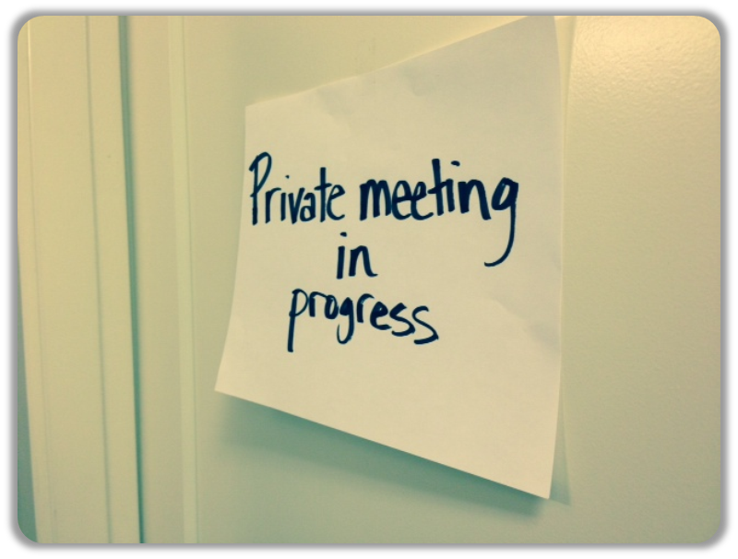
SettINg Up a CAB
Many sites have found ways to overcome barriers such as:
Language
Interpreter for CAB meetings; and
Translate CAB meeting minutes/materials.
Stigma, Attitudes, and HIV Disclosure
Confidential space;
Site staff to help run meetings; and
Confidentiality contracts.
Notes:
Language
In an effort to overcome language barriers, some sites have a site staff member interpret the meeting into Spanish. The interpreter participates in the meeting and interprets for Spanish-speaking CAB members at the same time.
Stigma, Attitudes, and HIV Disclosure
Participants in HIV studies may feel vulnerable to stigma, rejection and isolation due to their HIV diagnoses. Some people may not be comfortable disclosing their HIV statuses to others. They may worry about people revealing their diagnoses outside of CAB meetings.
Site CABs can help make CAB members feel safer by making CAB meetings a safe and confidential place. In one case, a Client Advocate & Retention Specialist runs the CAB meetings. This staff member also works with members to help overcome stigma.

Slide 5
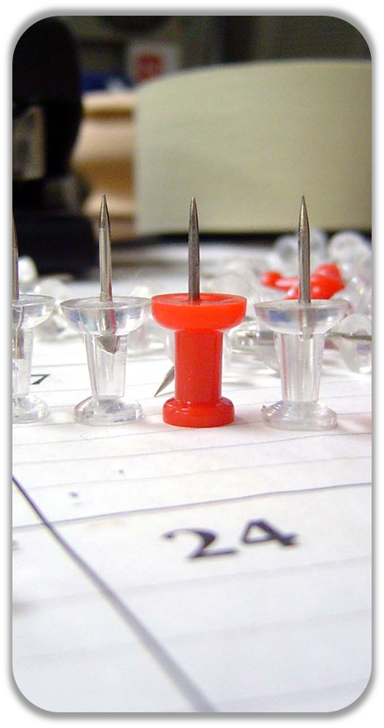
SettINg Up a CAB
Average Age
Recruit young people; and
Set up summer camps and afterschool groups for young adults..
Conflicting schedules
Schedule meetings in the evenings;
Providing teleconferencing options; and
Schedule meetings around a meal.
Notes:
Average Age
Most PHACS Site CABs do not have many adolescent/young adult members. Young people may feel out of place being around mostly adults. Reach out to this population and try to include them in recruitment. There may be alternative ways to involve young people in site community efforts. Some sites set up summer camps and afterschool groups for young adults.
Conflicting Schedules
It can be tough to schedule CAB meetings during a time that works for everyone. Some site CABs find it helpful to schedule meetings in the evening. Evening meetings allow for school-aged teens and working adults to come to the meetings. One site found it helpful to schedule meetings at 6:00 PM. This is right after work for many people. It allows members to come to the meeting on their way home from work. They eat dinner at the meeting and make it home before it gets too late. Other sites find it helpful to schedule meetings during lunchtime.
Consider providing teleconferencing options. This would allow CAB members to attend the meeting over the phone or internet. Some sites use site conference call lines or Skype.
In conclusion, it may always be challenging to schedule meetings at a time that works for all. Talk to site CAB members. Come up with a time that works for the most people, and try it out. Many sites have had to try out different times and wait and see what really works.

Slide 6
SettINg Up a CAB
Availability of Childcare
Set up child-friendly areas at meetings; and
Ask for site staff or CAB members to volunteer to supervise childcare during meetings.
Transportation
Bus passes;
Free parking; and or
Gas money.
Notes:
Availability of Childcare
CAB members may have a hard time coming to CAB meetings if they do not have childcare. Site staff or even other CAB members may be willing to babysit during CAB meeting. Some sites have a child-friendly area with books, movies, and toys. One site gives children an art project to work on during the CAB meetings.
Transportation
CAB members may not live near the meeting location. Some CABs encourage members to carpool to meetings. If funds are available, sites may offer transportation “perks” to CAB members like bus passes, free parking, or gas money. These can help make it less costly for CAB members to come to meetings.

Slide 7
SettINg Up a CAB
Mission Statement
Why do we exist?
Consider your goals for the CAB
What do we want to accomplish?
What do we want to do or learn?
Example: The mission of the PHACS CAB is to serve as a connection between researchers and community members in order to improve and optimize clinical research studies for children/families who are participants, and who are most affected by the re-search.
Notes:
Mission Statement
One of the first steps in setting up a CAB may include making a mission statement. Mission statements are often created by members of the CAB and CAB liaisons. A mission statement can help define the site CAB’s purpose. A mission statement answers the question, "Why do we exist?" As a group, consider your goals for the CAB. Think about what the group would like to accomplish. Some sites come up with yearly goals. They make sure to think about their mission statement as they come up with goals for the next year. Goals often have to do with what the CAB members want to do or learn.
Think about the PHACS CAB Mission Statement. Try to come up with a statement that supports the PHACS CAB Mission Statement. Make sure it also represents the site CAB’s own point of view.

Slide 8
SettINg Up a CAB
Retention
Keep in touch
Get involved
Show appreciation
Incentivize
Keep in Touch
Buddy system; ask CAB members to keep track of one another.
Reminders during clinic visits
Flyers
How do we keep our CAB members?
Notes:
Retention
Site CABs may have some trouble keeping members involved. Many site CABs have come up with new and exciting ways to retain their members.
Keep in Touch
CAB members who keep in touch, stay together! CAB members or Liaisons can volunteer to call CAB members with meeting reminders. Some sites send meeting flyers to CAB members by mail or email. Many CABs use a buddy system. Each CAB member has a buddy and is in charge of helping make sure they know about the scheduled meetings. Site staff members may remind CAB members about meetings during clinic visits.

Slide 9
SettINg Up a CAB
Get Involved
Appoint study CAB representatives
Define roles and responsibilities
Appoint CAB Leadership
Show Appreciation
Celebrate!
Personal connections
Accomplishment recognition
Notes:
Get Involved
One of the ways to get CAB members to stay in the CAB is to help them get involved with CAB responsibilities. The CAB may choose a representative to take part in study-wide conference calls like the PHACS CAB monthly conference call. PHACS and other similar studies may invite CAB members to attend yearly in-person meetings or retreats. There may even be opportunities for CAB members to attend professional conferences.
Many site CABs come up with roles and responsibilities for site CAB Leadership. Consider asking the CAB about CAB Leadership positions. Vote for CAB Leadership members, or take volunteers. This is a way to get CAB members more involved, and spread the CAB workload.
Show Appreciation
The CAB is a vital piece of the clinical research process. CAB members give very important feedback about the study to researchers. This feedback can be used to make the study better for study participants and researchers. Many sites have retained their CAB members by showing appreciation for the CAB’s hard work. In addition to helping with the CAB, site staff members at sites with active site CABs make personal connections CAB members. Some sites celebrate CAB member birthdays, holidays, and CAB accomplishments!

Slide 10
SettINg Up a CAB
Incecntivze
Learning opportunities
Professional workshops
Resume building
Keep in mind that incentives or “perks” are not just about money. Later in the presentation we’ll present different types of incentives; some involving money and some that can be produced without money.
Notes:
Incentivize
One of the most obvious ways to keep CAB members involved is to offer “perks” or incentives. Keep in mind that perks are not just about money. Perks can include learning opportunities, professional workshops, or resume building. (More information on incentives later in the presentation)

Slide 11
SettINg Up a CAB
Funding
Different groups may be responsible for funding.
Be mindful of state and institutional rules and regulations about funding.
Some materials for CAB activities may be donated.
Talk to the site Principal Investigator about funding specifics.
Notes:
Funding
Sites may or may not have funds available for their site CABs. Different groups may be responsible for funding. The research study may fund site CABs, but funding can also come from donations from outside organizations. One PHACS site CAB receives some funding from the local police department. Be mindful of state and institutional rules and regulations about funding. Talk to the site Principal Investigator about funding specifics.
Keep in mind that some materials for CAB activities may be donated. Local businesses may be willing to donate food or services. One site has received food donations from local businesses for their holiday party. Local volunteers came to help with the party and take pictures with Santa. Reach out to other community groups connected with the site. They may have a list of local businesses that actively participate in community service and/or give out donations.

Slide 12
SettINg Up a CAB
Sites may be able to use CAB funds for the following:
Food/drinks at CAB meetings
Materials for CAB meetings
Classes and workshops
Resources
Raffle prizes
Incentives
Childcare and childcare materials
Transportation reimbursement

Slide 13
SettINg Up a CAB
Some sites have looked for additional support through fundraising to help pay for extra activities. There are many ways to fundraise!
Holiday activities like gift wrapping for donations, or handmade holiday cards
Letters to local business
Support ribbons
Bake sales
In some cases, fundraising can be used to support outside needs in the greater community.
Important Tip: Hold the bake sale on a pay day!
Notes:
Fundraising
Although many sites find their own funding to be enough, some sites feel the need to do fundraising activities. Materials for CAB meetings may often be provided by the site. However, some sites have looked for additional support through fundraising to help pay for extra activities. These additional activities such as parties, raffles, and other fun activities may help keep CAB members involved. Although these kinds of activities are not typically included in budgets for research studies, they may help keep CAB members involved and enthusiastic.
There are many ways to fundraise! Many site CAB fundraisers have to do with using current CAB member skills and talents. If there are creative cooks in the CAB, try holding a bake sale. If there are artistic members of the CAB, try holding an art auction or festival. Take donations for CAB member art. One site CAB sold handmade scarves and ear warmers to hospital staff. There are also often fundraising opportunities during the holidays. Set up a wrapping table at an approved location. CAB members could wrap gifts and accept donations. Accept donations for handmade greeting or holiday cards. Consider other ways your CAB can utilize your CAB members’ hidden talents!
Below are a few ways site CABs have raised money:
Letters to Local Business
One site CAB sent letters to medical providers and local businesses. In the letters, they explained the purpose of their site CAB. They requested support for funding. This CAB used the funds to purchase gifts for their annual holiday party.
Be mindful that some sites may have regulations about sending letters to local businesses. Check with the site Principal Investigator to find out if approval is needed.
Ribbons
One site CAB made support ribbons out of construction paper. They posted the ribbons in the clinic. People donated $1 to write their name and/or a message on the ribbon. This CAB used the funds for site CAB meeting materials.
Bake Sales
One site CAB held a bake sale around Thanksgiving. CAB members either made or brought baked goods to sell. They set up the bake sale table at the front entrance of the hospital. The CAB raised over $600 for their annual holiday party. Consider asking CAB and site staff members to help bake.
In some cases, fundraising can be used to support outside needs in the greater community. This includes emergency aid, camps for HIV-affected children, and housing support. Some site CABs fundraise for other organizations.
Site CABs have raised money to participate in annual AIDS Walks together. These kinds of fundraising efforts do not directly fund site CABs, but they help the CAB participate in outside activities and bond together.
Be sure to check with site staff for approval before organizing any fundraising activities. This is especially important because each site may have different rules and regulations regarding permitted fundraisers. If you are unsure of your site’s policy, it may help to brainstorm a few ideas with the site CAB first. Then present the ideas to site staff.

Slide 14
SettINg Up a CAB
Incentives
Food/drink
Transportation
Prizes
Money and gift cards
Access to educational resources
Internet access/telephone access
Networking with site staff and other CAB members
Guest speakers
Parties
Leadership and professional opportunities
Workshops
Emotional support
Notes:
Incentives
Depending on the funds and resources available at the site, site CABs may offer incentives or “perks” to their CAB members. Remember, many incentives do not require money!

Slide 15
SettINg Up a CAB
Food/Drink
Full meals
Snacks
Gift cards for local restaurants
Tips
Plan food/drink options based on the time of the meeting
If CAB member availability is an issue, consider planning meetings around a meal
Notes:
Food and Drink
Depending on the time of the CAB meeting, site CABs might want to serve food and/or drinks during site CAB meetings. Some CABs provide full meals. Other CABs provide snacks. This can be an incentive to get CAB members to want to come to meetings. It can also help CAB members stay in the CAB. For example, CAB members may not want to come to meetings right after work because they are hungry. In this case, it may be helpful to provide dinner during or before/after the meeting.
Try to plan food/drink options based on the time of the meeting. One site CAB held meetings at 6:00 PM. This time was convenient because it was right after work. At some point, this site stopped providing food and drink during the meeting, and instead the site gave CAB members gift cards for local restaurants. This was an incentive for some CAB members. However, other CAB members didn’t have time to go to the meeting and then get dinner after the meeting using the gift cards. The site CAB noticed that because of this change, some CAB members stopped coming to meetings. Talk to site CAB members. If options are available, ask for their preference (gift cards or food during meetings).

Slide 16
SettINg Up a CAB
Transportation
Free parking/parking vouchers
Mileage reimbursement
Prepaid subway/metro cards
Carpools
Taxi vouchers
Bus tokens
Cash for transportation reimbursement
Notes:
Transportation
One of the barriers to retention is transportation. It may be financially or physically difficult for CAB members to get to CAB meetings. Therefore, some sites offer transportation options. Options for transportation incentives include:
· Free parking/parking vouchers;
· Mileage reimbursement (i.e., total miles traveled to and from the meeting X $0.565 per mile);
· Prepaid subway/metro cards;
· Carpools;
· Taxi vouchers;
· Bus tokens; and
· Cash for transportation reimbursement.

Slide 17
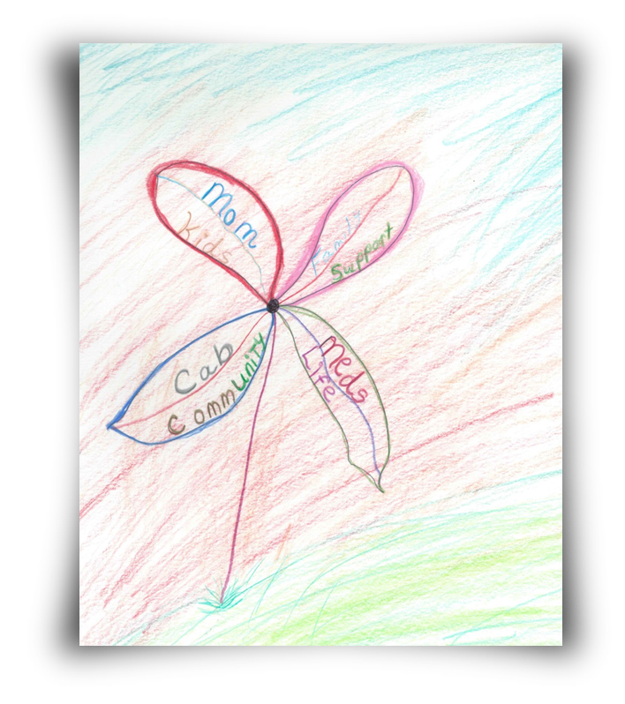
SettINg Up a CAB
Prizes
Prizes are good alternatives if your site has restrictions about money incentives.
Local businesses may donate prizes.
Money and Gift Cards
Available of monetary compensation varies by site
Sites that do not allow monetary compensation may allow gift card options
Notes:
Prizes
Some sites offer prizes during CAB meetings. There may be site restrictions about monetary incentives (money). This means that although the site is not allowed to hand out money, they may be able to give out goods. One site raffles off prizes during CAB meetings. Raffle prizes include movie tickets, restaurant gift cards, and candy. Prizes are a great way to give something special to CAB members and show appreciation.
Prize giveaways are especially useful for sites with restrictions about monetary incentives. Remember, prizes don’t necessarily need to be purchased with CAB funds. It may be possible to talk to local businesses and ask for donations. For example, try talking to a local movie theatre. They may be able to donate movie tickets or food vouchers. Be sure to check with site staff about options for prizes.
Money and Gift cards
Some site CABs provide compensation (money) for CAB members who attend CAB meetings regularly. Some sites are only able to compensate CAB leadership. Availability of monetary compensation varies by site. Sites may compensate CAB member anywhere from once per year to once per meeting. As mentioned earlier, there may be site restrictions about monetary incentives.
Although sites might not be allowed to hand out money, they may be able to give out gift cards. CABs give out gift cards for movie theatres, restaurants, and stores. Be sure to check with site staff about options for monetary compensation and gift cards.

Slide 18
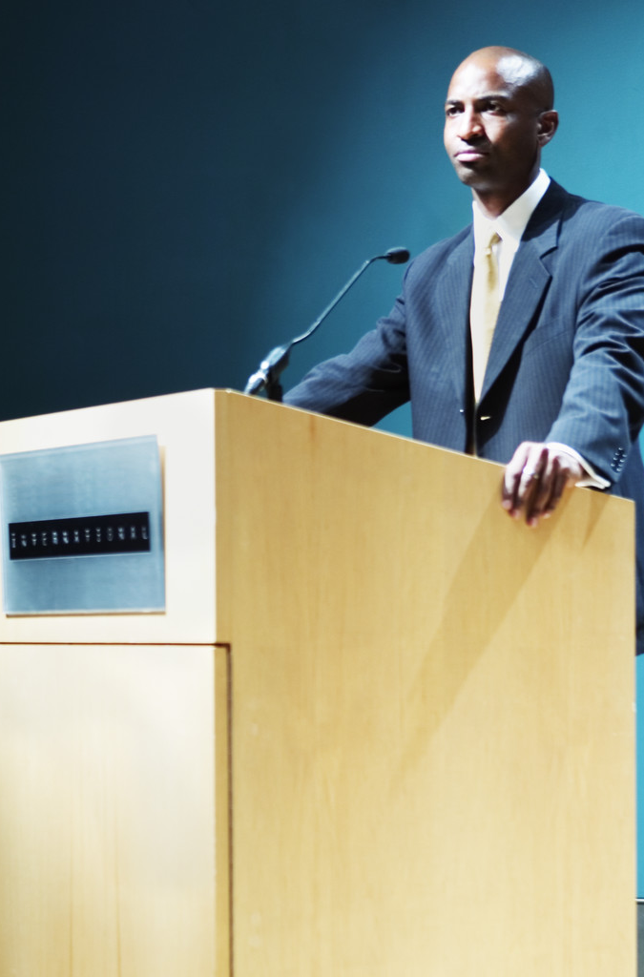
SettINg Up a CAB
Networking, Access, and Guest Speakers
Meet caregivers and site staff
Availability of health education resources
Educational guest speakers
Parties
Holidays
Birthdays
Check with site staff for funding options
Notes:
Networking, Access, and Guest Speakers
CAB meetings may give CAB members the chance to meet other study caregivers and/or participants. The CAB provides a place for CAB members to learn and give feedback about the study. At many sites, site staff attend CAB meetings. This allows CAB members to meet the researchers and ask important questions
Many sites offer health educational materials to CAB members during CAB meetings.
Some site CABs invite guest speakers to present a topic of interest during CAB meetings. CAB members are given the opportunity to learn about a topic from an expert in the field.
Parties
Some CABs throw parties for the CAB. CAB members and their family members are invited to come parties. Parties may be expensive, so be sure to check with the site staff about funding options for parties.

Slide 19
SettINg Up a CAB
Leadership, Professional Opportunities, and Workshops
CAB Leadership positions
Employment opportunities
Professional conferences
Educational Workshops
Emotional Support
Support groups
Support resource sharing opportunities
Notes:
Leadership, Professional
Opportunities, and Workshops
Many site CABs have leadership positions. This may include an elected CAB Chair and Vice Chair. Leadership experience may help CAB members in their professional lives. Some sites even offer professional opportunities to CAB members. This may include employment opportunities at the site and invitations to professional conferences.
Some sites offer workshops to CAB members during CAB meetings. One site held a writing workshop to help CAB members improve their writing skills. Funds might not necessarily be needed to hold workshops for CAB members. Think about the individuals and resources available at the site. Some sites are connected to universities. If possible and if it’s permitted by the CAB, students may be willing to hold a workshop during a CAB meeting.
Emotional Support
CABs often provide a place for HIV-infected and affected people to give and seek emotional support. Many CAB members have stated that their CABs also function as support groups. Talk to site CAB members about their preferences for meeting organization and structure. Think back to your site CAB mission statement: is part of the CAB’s mission to support one another?

